Slide 1
SPORTEVE – A WEB APPLICATION FOR ORGANIZING SPORTING EVENTS
Fakultet Elektrotehnike i Računarstva
Menthor: Doc. Dr. Sc. Marina Bagić Babac
Author: Jura Darko Šlehan

Slide 2
What is SportEve?
Main features?

Slide 3
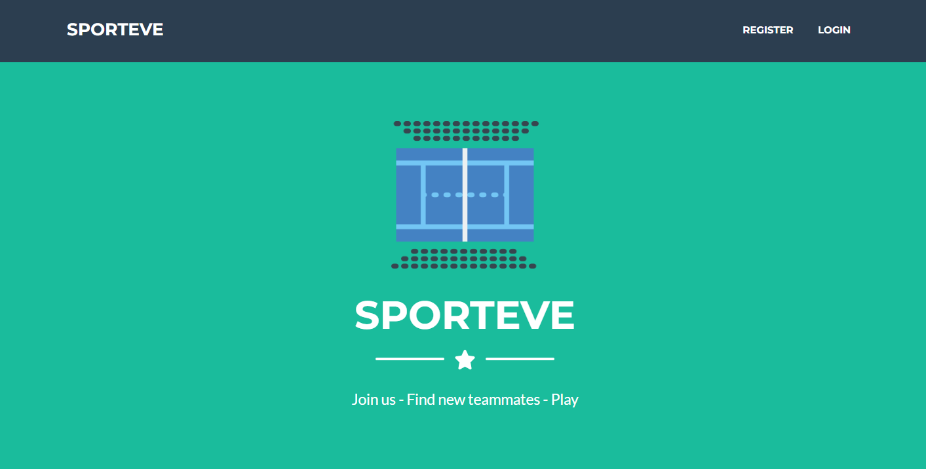
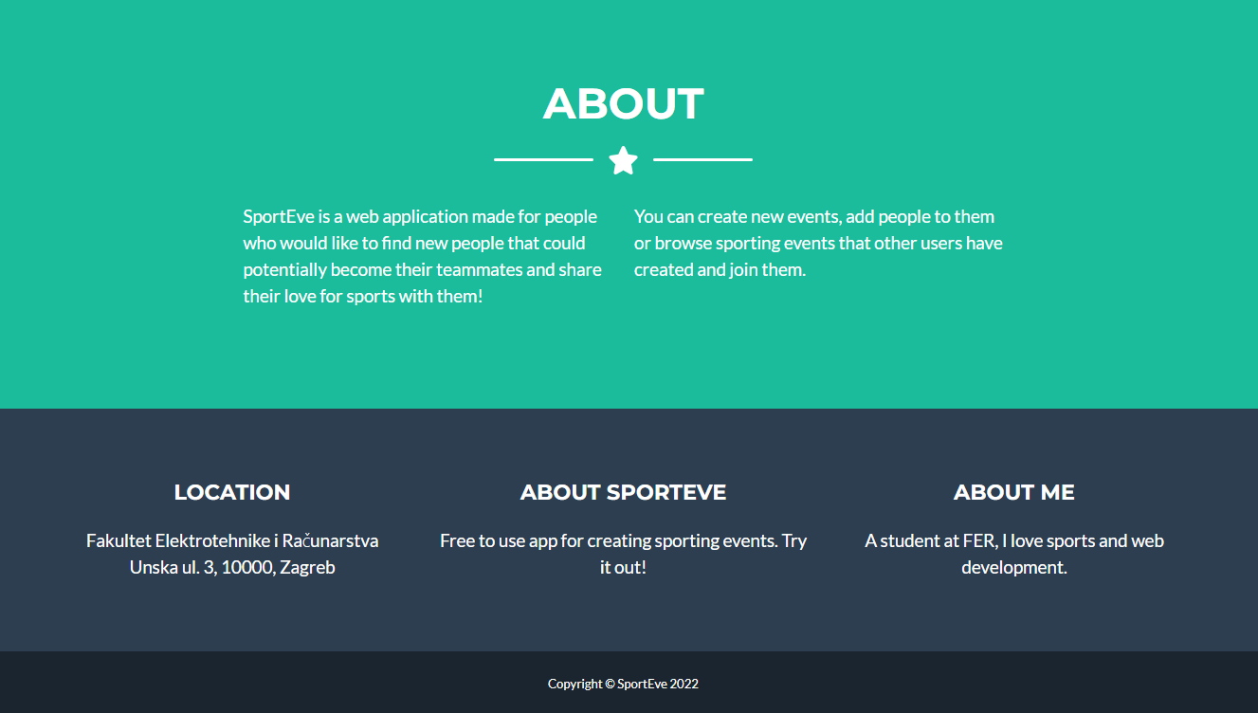
Landing page

Slide 4

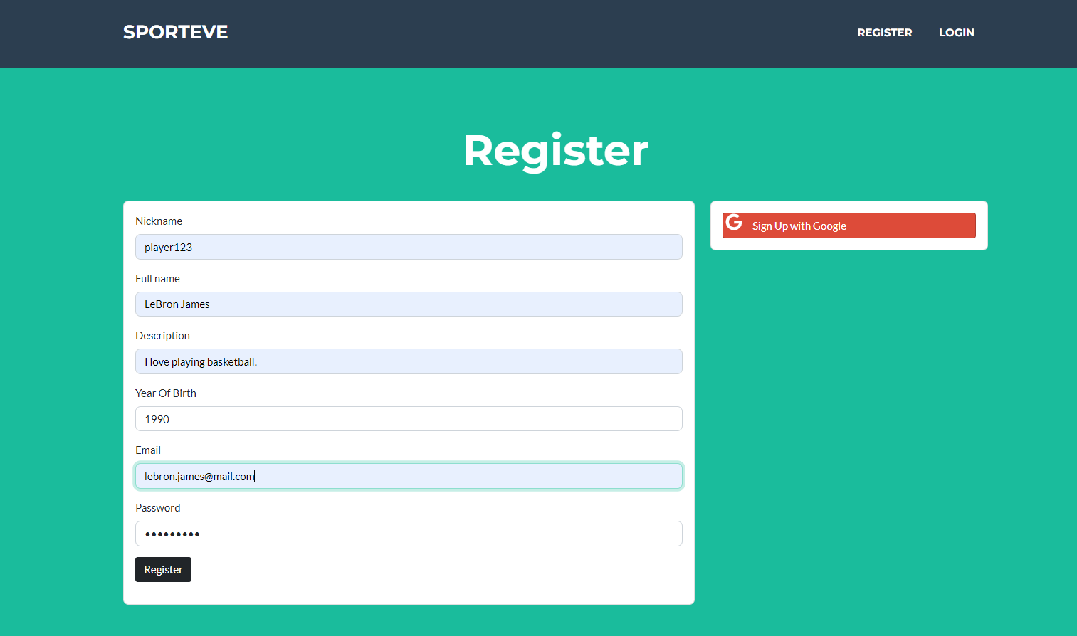
Registration
Creating a new account
2 options:
Google account
Email and new password

Slide 5
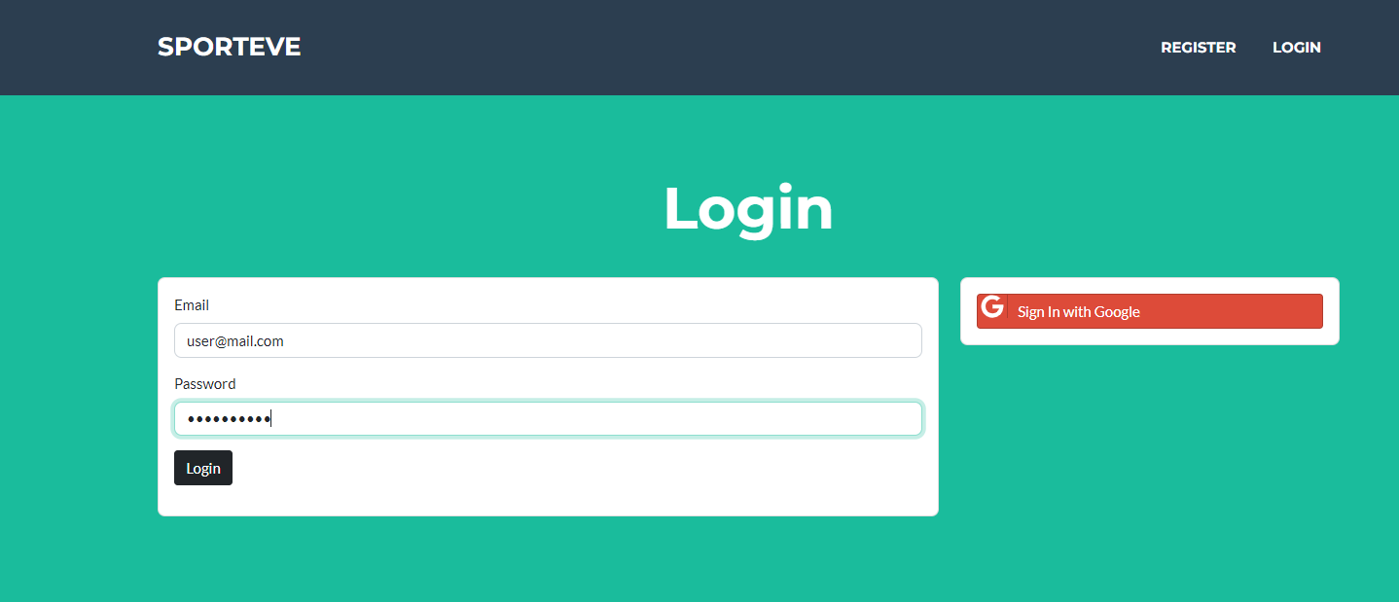
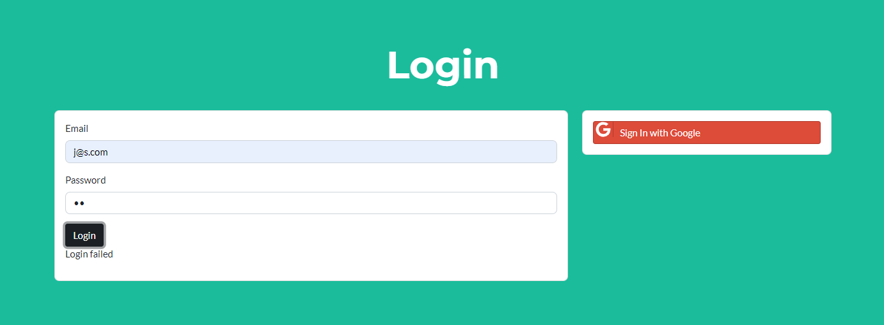
Logging-in

Slide 6
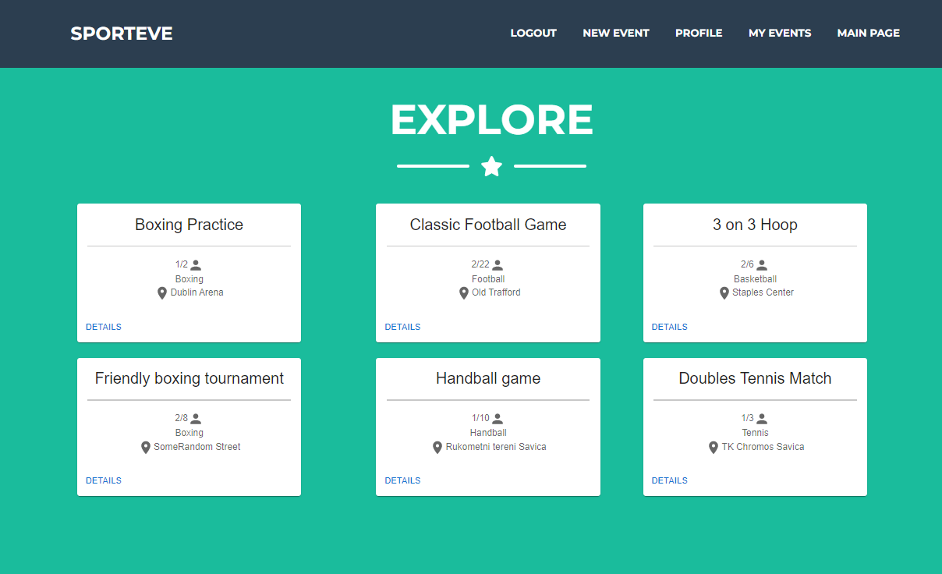
Navigation

Slide 7
Main page
Exploring new events
Basic information about every event
Details for more information

Slide 8
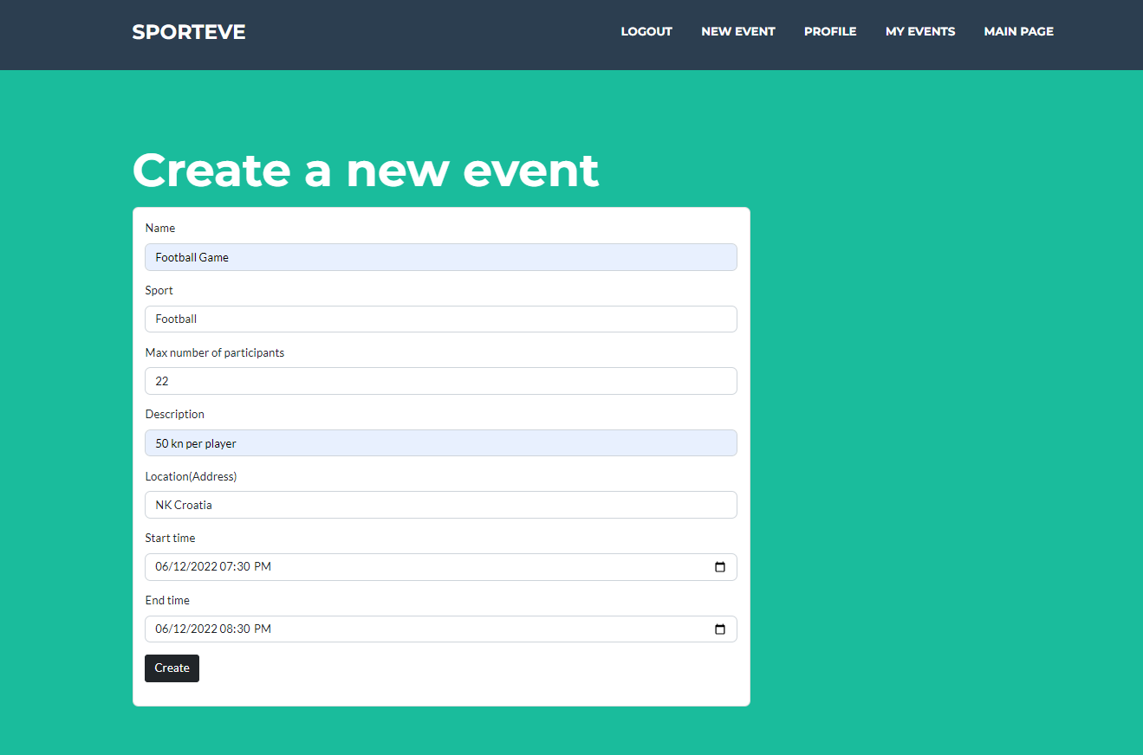
Creating a new event

Slide 9
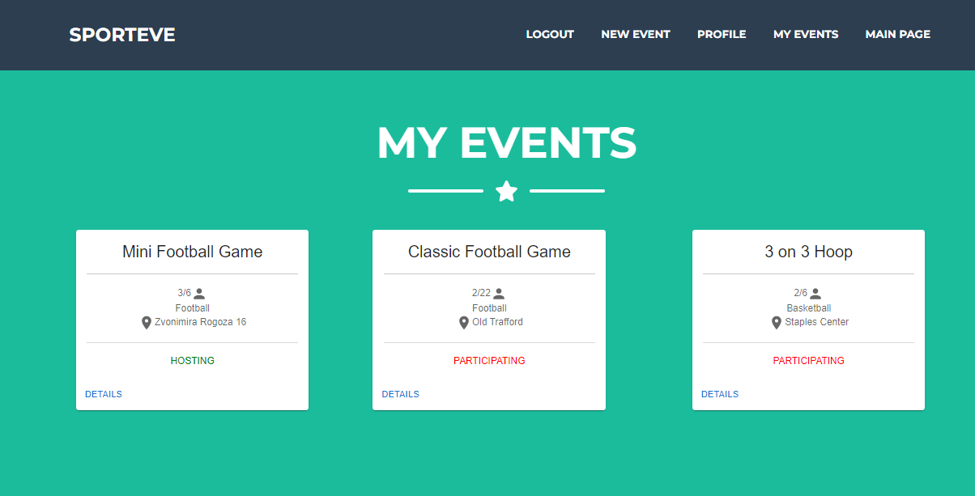
My events
Current user’s events
Hosting or participating

Slide 10
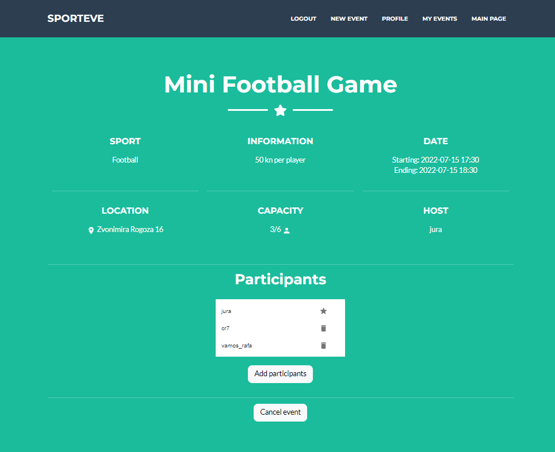

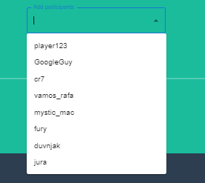
Event page – host view

Slide 11
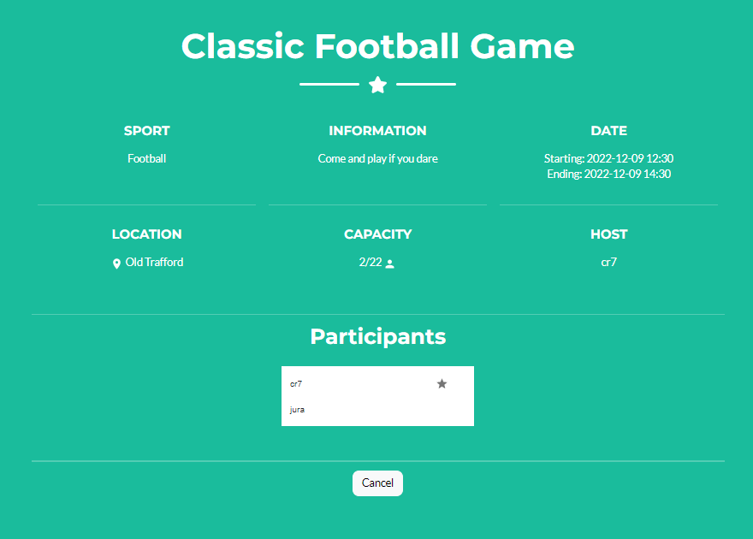
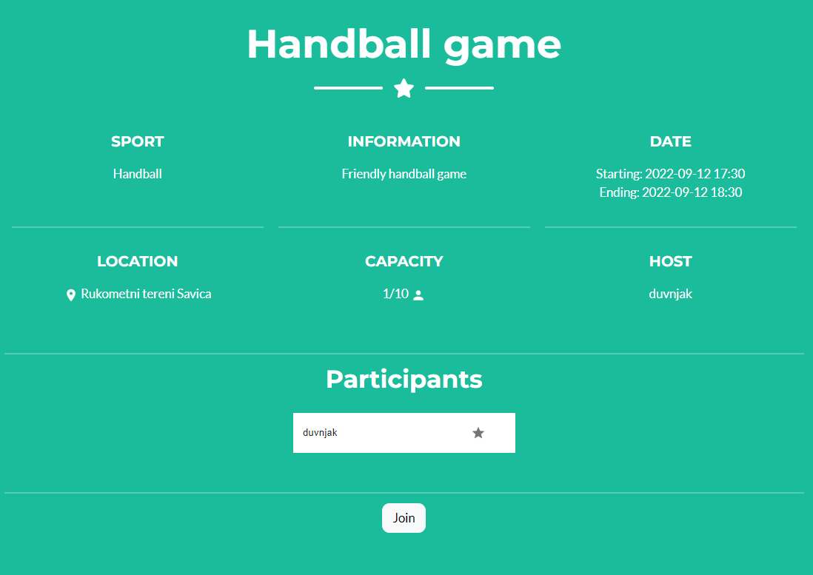
Event page – other users
Participating
Not participating

Slide 12
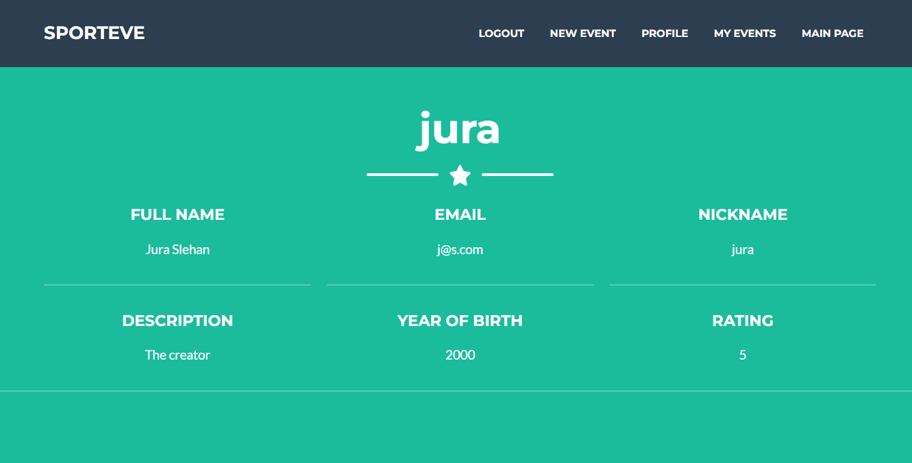
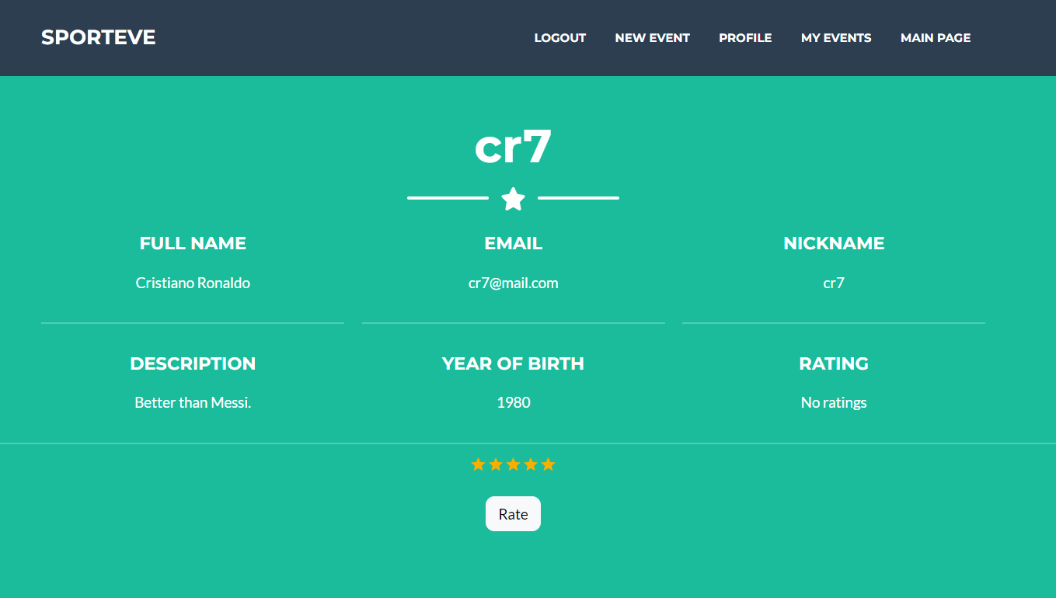
Viewing a user

Slide 13
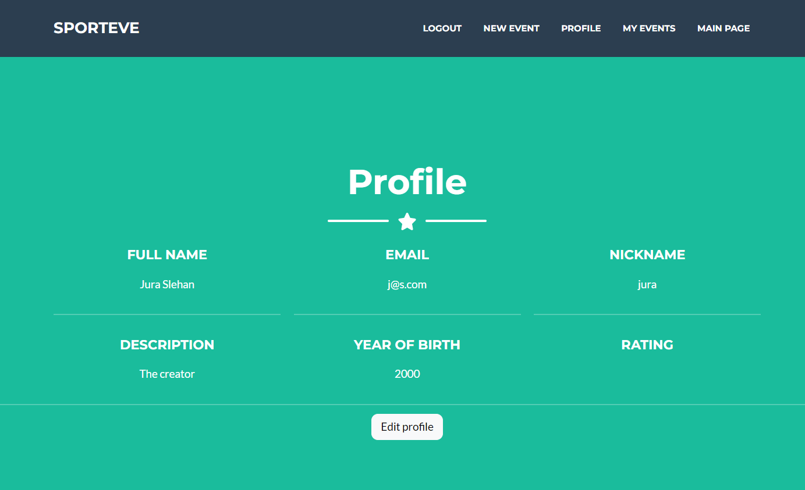
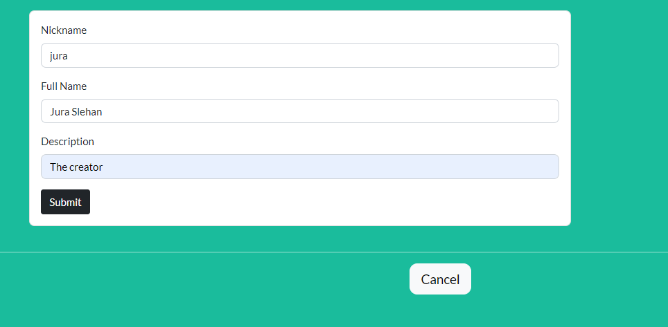
Profile

Slide 14
Conclusion

Slide 15
Thank you!

